Slide 1
BANK MANAGEMENT System
By Vansh :E22CSEU1194
Nitish Singh: E22CSEU1218

Slide 2
ABSTRACT
In the realm of contemporary banking, effective data administration and quick retrieval are essential for maintaining seamless operations. The Bank Management System (BMS) described in this abstract was created to solve the problems associated with data organization and retrieval in banking contexts. It was written in the C++ programming language and utilized AVL Trees.
Optimizing the administration of client accounts, transactions, and related data inside a financial infrastructure is the main objective of this system. Because of its ability to self-balance, AVL Trees are used to preserve the data structure's integrity and guarantee effective insertion, deletion, and retrieval processes.

Slide 3
INTRODUCTION
This BMS's main goal is to transform banking data management through operational efficiency through the use of AVL Trees. A balanced binary search tree variation called an AVL tree provides logarithmic time complexity for important operations such as search, insertion, and deletion. This innate efficiency makes it possible to quickly access and manipulate enormous amounts of data, which is essential for account management and real-time transaction processing.
An extensive examination of the application of AVL Trees within the framework of a bank management system is presented in this study. It clarifies the design concepts, features, and benefits of using AVL Trees to manage customer accounts, guarantee data integrity, streamline transaction processing, and give banking staff a safe yet user-friendly interface.

Slide 4
KEY FEATURES
Optimized Data Handling: Data organization and retrieval have been transformed by the use of AVL Trees. This self-balancing data structure maintains data integrity while enabling quick access to client accounts and transaction information, ensuring efficient operations.
Improved Performance: The BMS can do quick searches, insertions, and deletions thanks to the logarithmic time complexity of AVL Trees. This has greatly enhanced system performance overall and transaction processing times, which are critical in the quick-paced banking industry.
Scalability and Reliability: As data volumes increase, AVL Trees' self-balancing capability guarantees that the system will continue to function effectively. No matter how big the operation, the intrinsic balance ensures steady and reliable performance.
User-Friendly Interface: Bank workers can execute a variety of operations with ease thanks to the BMS's user-friendly interface. This involves overseeing

Slide 5
PROBLEM STATEMENT
• The bank management system needs to be improved in order to handle a large number of transactions efficiently and securely. • An AVL tree needs to be implemented to manage the large number of transactions, as it is a self-balancing binary search tree that allows for fast retrieval of data. • The AVL tree should be designed to store and retrieve data related to accounts and transactions in order to provide a secure, efficient, and user-friendly ATM management system.

Slide 6
Methods that we have used
We are using AVL data Structure which consist of: 1. Menu() 2. Height() 3. Left_rotation 4. Right_rotation 5. Right_left_rotation 6. Left_right rotation 7. Min() 8. Balance 9. Insertion 10. Deletion() 11. FindMax() 12. Search() 13. PrintData()
We are using AVL data Structure which consist of: 14. Print_for_admin() 15. Deosit() 16. With_draw() 17. Change_info() 18. Check_acc_pin() 19. Create_acc() 20. Admin_panel() 21. Saff_panel() 22. ATM panel(); 23. Main();

Slide 7
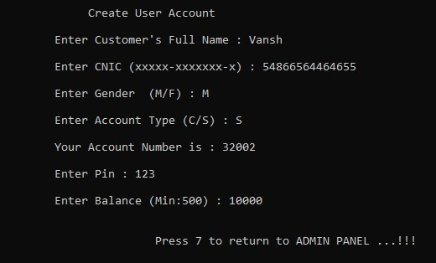
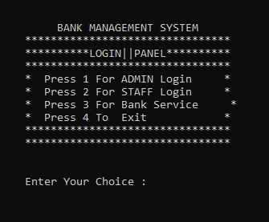
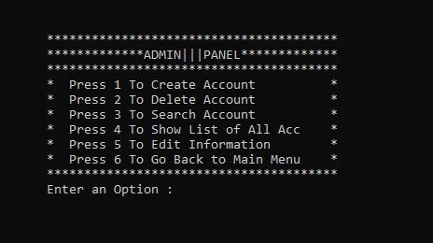
Output

Slide 8
